Slide 1


LBW Insurance
Chan Siang Yong
Sarah Tay
Lyu Bo Wen
Xu Jia Wen
Wang Ye Chun
Jovin Ng

Slide 2
Over view
1. Intro of business
2. Business scenario
3. Systems
4. Web services
5. Breakdown of technical diagram in steps
6. Beyond the lab
7. Demo

Slide 3

Introduction of Business

Slide 4


LBW Insurance
Provides car insurance Offers premium reduction for safe drivers Automatically notifies clients via email of their eligibility status upon nearing expiry of their current insurance plan

Slide 5
Involved IT Systems

Slide 6
Auto-checking System
Web-based application
Checks the current clients that are about to expire in a month
Using tibco the client’s details(application.xml)
Send using a queue(q.start)

Slide 7
Waiting List System
Applications passed through q.eligible
Updates both the Waiting List database and Insurance Client database
Sends an email with status (driving risk assessment result) and link of website inside

Slide 8
Black List System
Applications passed through q.uneligible
Updates both the Black List database and Insurance Client database
Sends an email with status (driving risk assessment result) and link of website inside

Slide 9
Web services

Slide 10




Web Service
Sensor Tracking Web Service
OBD Company Web Service
Traffic Police Web Service
Driver Risk Assessment Web Service
Notes:
Car driving log db

Slide 11
Technical Diagram

Slide 12



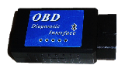








Insurer’s web-application to initiate process
(Source: coded)
Traffic Police Web Service (RESTful)
(source: Coded)
Sensor Tracking Web Service
(RESTful)
(source: Coded)
Insurance Client DB
1
3
4
OBD Company Web Service
(RESTful)
(source: Coded)
Auto-Checking System
2
Car Driving Log DB
Integration
Middleware
5
6
Driver Risk Assessment Web Service
(SOAP)
(source: Coded)
Blacklist DB
Waitinglist DB
Black list System
Waiting list System
Client

Slide 13

Insurance Client DB
Insurer’s web-application to initiate process
(Source: coded)
1
Auto-
Checking System
application.xml
(application.xsd)
Integration
Middleware
2
JMS
P q.application (Q)
C q.application (Q)

Slide 14
Traffic Police Web Service (RESTful)
(source: Coded)
3
HTTP
JSON
Integration
Middleware

Slide 15
Sensor Tracking Web Service
(RESTful)
(source: Coded)
4
HTTP
OBD Company Web Service
(RESTful)
(source: Coded)
JSON
Integration
Middleware
Car Driving Log DB

Slide 16
5
HTTP
Driver Risk Assessment Web Service
(SOAP)
(source: Coded)
JSON
Integration
Middleware

Slide 17
Integration
Middleware
6
P q.eligible (Q)
modified_application.xml
(modified_application.xsd)
JMS
C q.eligible (Q)
SMTP
Waitinglist DB
Waiting list System
JDBC
Client

Slide 18
Integration
Middleware
modified_application.xml
(modified_application.xsd)
6
P q.uneligible (Q)
JMS
C q.uneligible (Q)
Black list DB
SMTP
JDBC
Black list System
Client

Slide 19
Beyond the lab

Slide 20




TIBCO Email
Server Plugin
Repository
https://github.com/lvber/EI
AXIS2 Web Service Engine
SOAP Web Service
Notes:
First of all we use Git as our repository. You can find all our project code on this website.
Secondly, we use tibco email plugin and use SMU smtp server to send email to our client.
Thirdly, our SOAP web service use AXIS2 as web service engine.

Slide 21

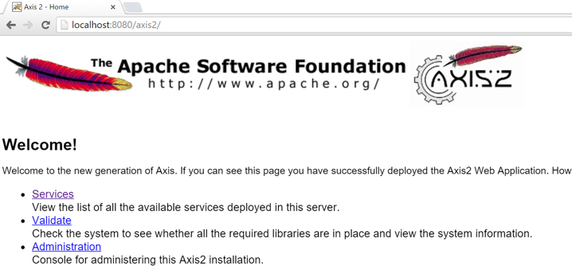


How AXIS2 Works?
1.Apache Axis2 is a Web Services ENGINE
2.Plain Old Java Object(POJO) Web Services using Apache Axis2
Notes:
http://www.codejava.net/java-ee/web-services/developing-pojo-web-services-using-apache-axis2-ant-and-tomcat

Slide 22
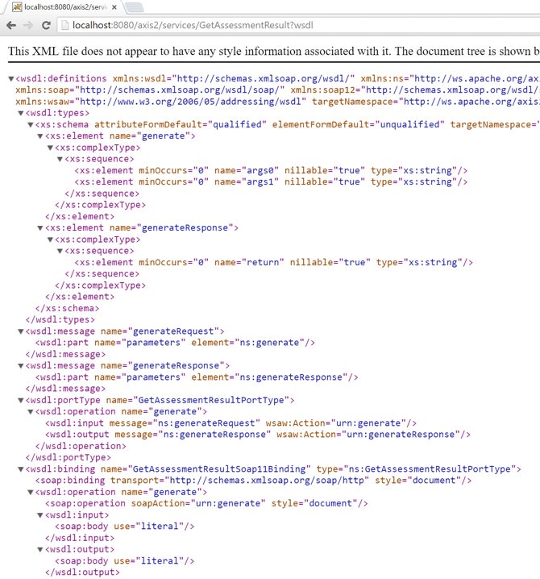
How AXIS2 Works?
3. Describe the Service - WSDL

Slide 23
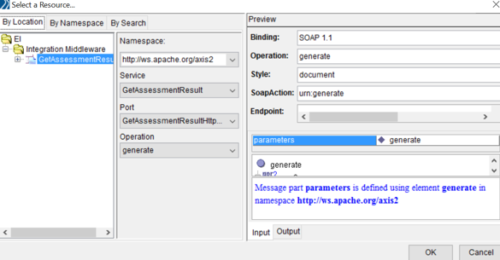
How AXIS2 Works?
4. Put class file into POJO folder and deploy it on Tomcat
~\apache-tomcat-7.0.63\webapps\axis2\WEB-INF\pojo
5. Set up ‘SOAP request-reply’ in TIBCO and import WSDL file

Slide 24
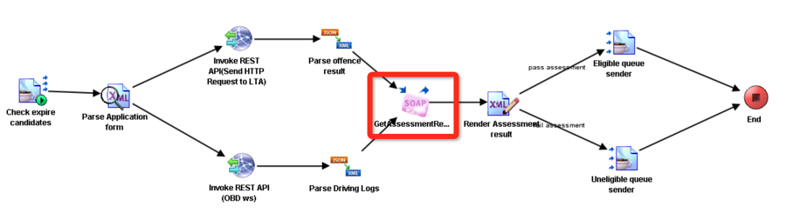
How AXIS2 Works?
6. As a result, the SOAP web service could run properly

Slide 25





1
Query for clients that are about to expire from Client database
Client database
Black list database
Waiting List database
Client database
3
Driving records passed into Driver Risk Assessment
Email is sent to notify clients after databases are updated
Auto-Checking System
Driver Risk Assessment (SOAP)
6
JMS
HTTP (request)
Black List System
Customer details
Driving records
JMS
Client Assessment Result
Integration Middleware
4
Depending on the assessment result will be sent to either system
2
Invoke both the web services
HTTP (request)
JMS
Completed Status
Waiting List System
LTA Web Service (RESTFUL)
OBD Web Service (RESTFUL)
Black List/ Waiting List system sends a message back to Auto-Checking System.
7
HTTP (request)
HTTP (request)
Driving records
Driving records
5
Updates respective database s based on which system it is sent to

Slide 26


DEMO

